Slide 1


Greener Pastures
Kevin Sheekey
Kyle Pavelka
Matthew Brown
Meriane Franco
Ravi Patel
03/20/2021

Slide 2

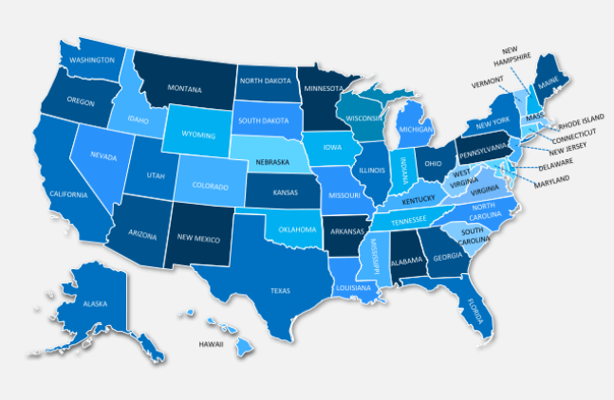



Motivation
Is there a better place to go now?
No matter the current condition people have,
there is always a search for BETTER.

Slide 3

What does BETTER mean?
Economics
Job opportunities
Health system
Fun & Entertainment
Cost of living
Maslow's Pyramid of Human Needs

Slide 4
Data needed
Economics
Business opening vs closure
Job opportunities
Availability & salaries
Health system
Rating from users
Fun & Entertainment
Rating from users
Cost of living
Housing cost

Slide 5
Data Source
Economics -Business opening vs closure
EconomicTracker · GitHub [EconomicTracker/oi_tracker_data_dictionary.md at main · OpportunityInsights/EconomicTracker · GitHub]
Job Availability & salaries
https://www.bls.gov
EconomicTracker · GitHub [EconomicTracker/oi_tracker_data_dictionary.md at main · OpportunityInsights/EconomicTracker · GitHub]
Housing cost
Numbeo.com
Parks
Google API Search Nearby “Places = park” and Rating
Health system scores
Google API Search Nearby “Places = hospitals” and Rating

Slide 6
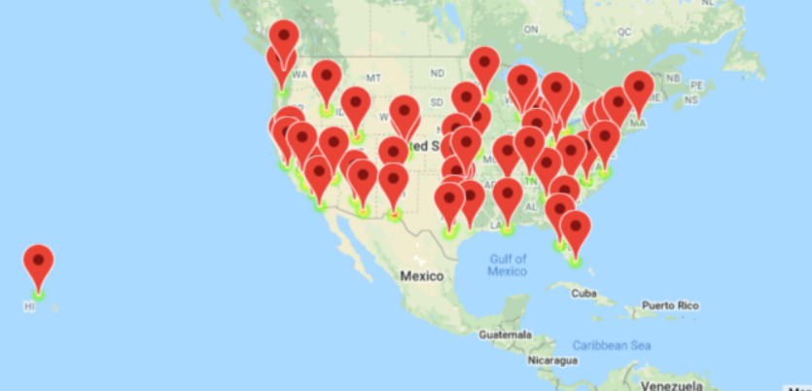
Where is our Greener Pasture?
Our app will evaluate the data for 53 American cities and rank them on each human need listed and overall

Slide 7
Data cleanup & exploration
Estimated Salary by city
Notes:
Good Morning, we are Greener

Slide 8
BLS Modeled Wage Estimate (MWE): Expected $/hr
Modeled Wage Estimate Background
(https://www.bls.gov/mwe/)
Key Concepts Employed
Encoded Series Names where search parameters for the specific MWE are contained within the index name.
Obtaining Data from a Web Page not API, not csv.
Dynamic Variable Name creation using dictionaries to for use in decoding.
Augmenting Results using wider search parameters whenever a value could not be found (even if the augmented value is just “Not Found”)
Providing a .csv Output for other team members to use.
Provide annual estimates of average hourly wages for occupations by selected job characteristics and within geographical location.
Produced using a statistical procedure that combines survey data collected by the National Compensation Survey (NCS) and the Occupational Employment Statistics (OES) programs.
Most recent data is from 2019, but plenty of data and provides a good challenge for data cleanup methods.
GOAL: Decode the BLS series to provide a table of MWE values for a trimmed list of 21 occupation types for every city in the GEO dataset. Merge it with the main GEO city dataset by matching BLS region names to GEO city names.

Slide 9
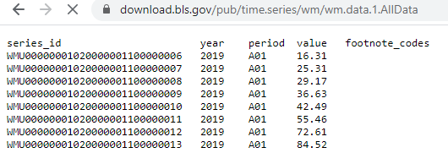
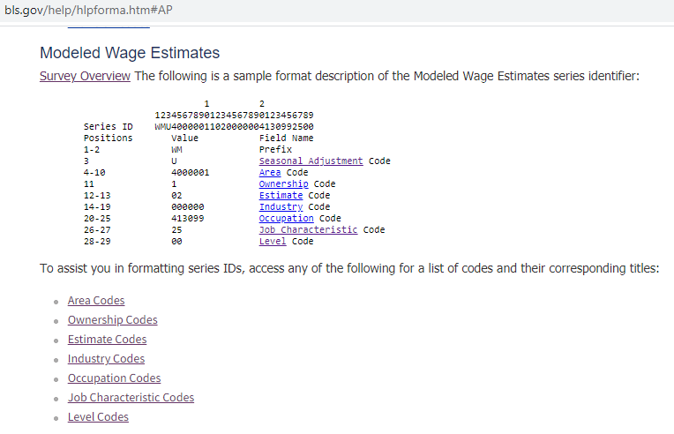
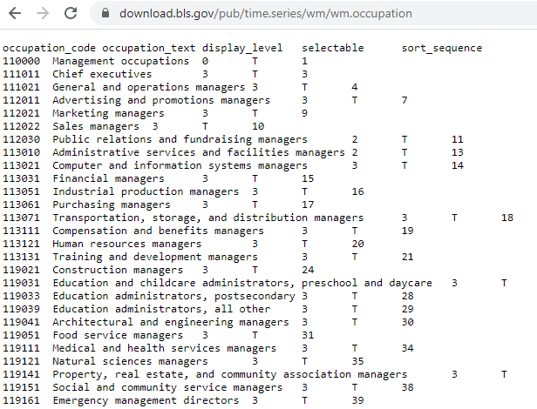
Encoded Series Names
KEY TAKE AWAYS
Data
Substrings at certain positions inform what the series represents.
Documentation exists to help translate.
Can the process of retrieving data and translating using provided dictionaries be integrated/automated? YES!
Translation
Guide
Dictionary Data

Slide 10
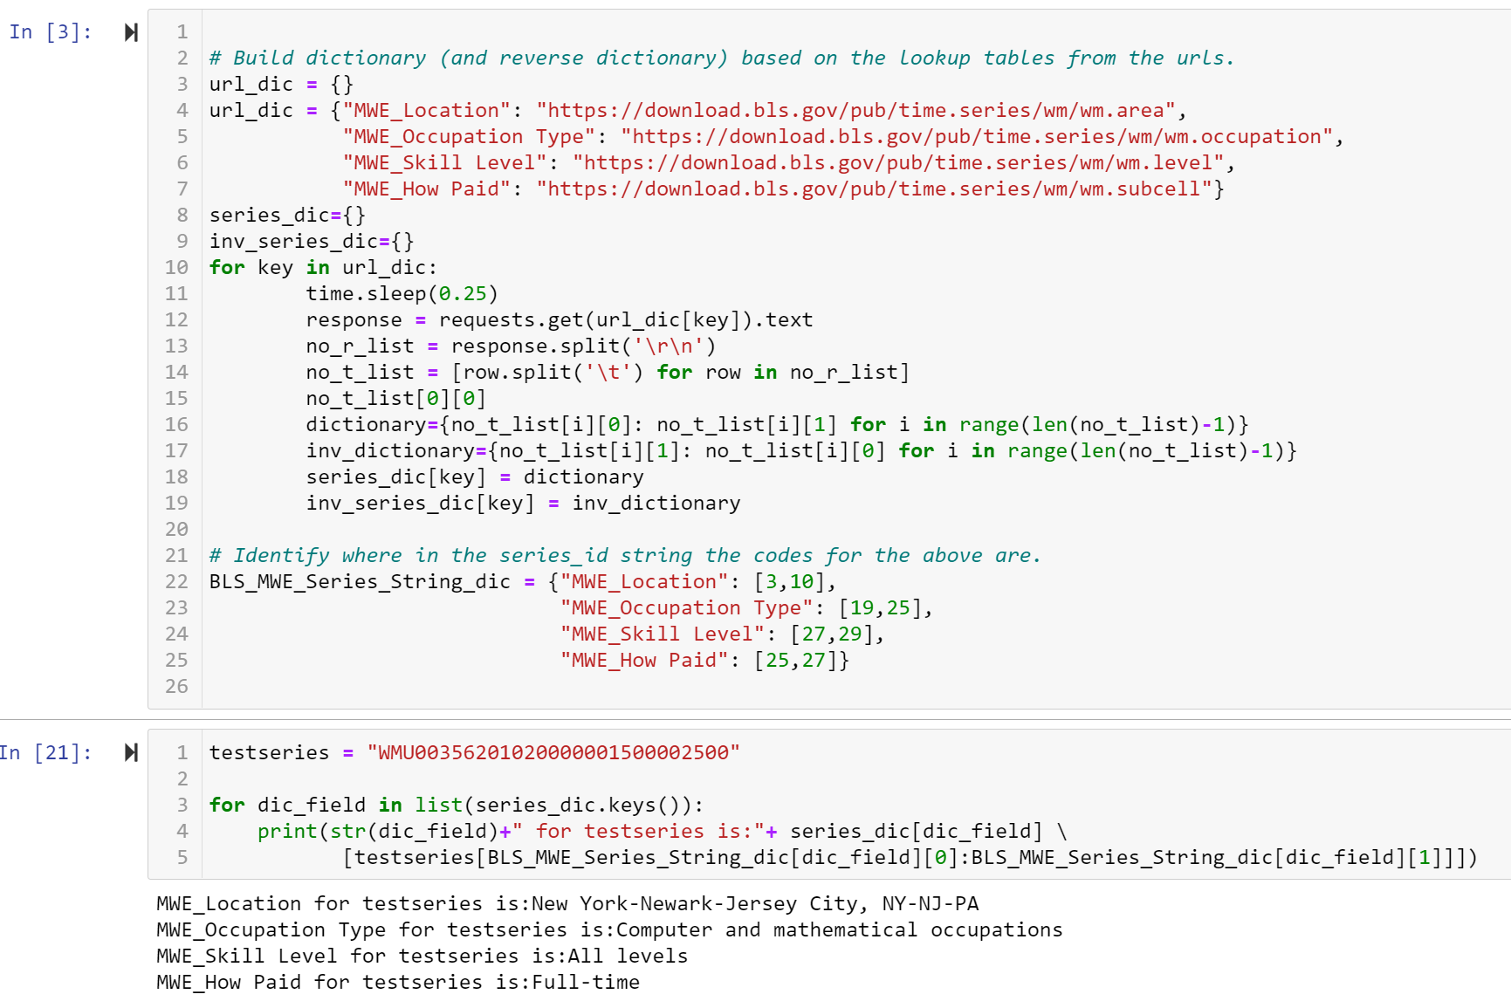
Encoded Series Names → Obtaining Data from Webpage
→ Dynamic Variable Name/Dictionaries
KEY TAKE AWAYS
Able to request from the URLs.
Custom code writes the data to dictionaries, for each URL.
dic_field chooses which dictionary is getting looked at.
Based on which dictionary in dic_field, the for loop knows which substring to extract.
The substring is fed to the dictionary as a key for a corresponding value.
To summarize, series_dic[dic_field][series_subtring] can lookup the piece of the series name in the corresponding dictionary that contains it!
Note:
This region code combines two or more series which may pose a problem for unique row creation. (next slide)

Slide 11
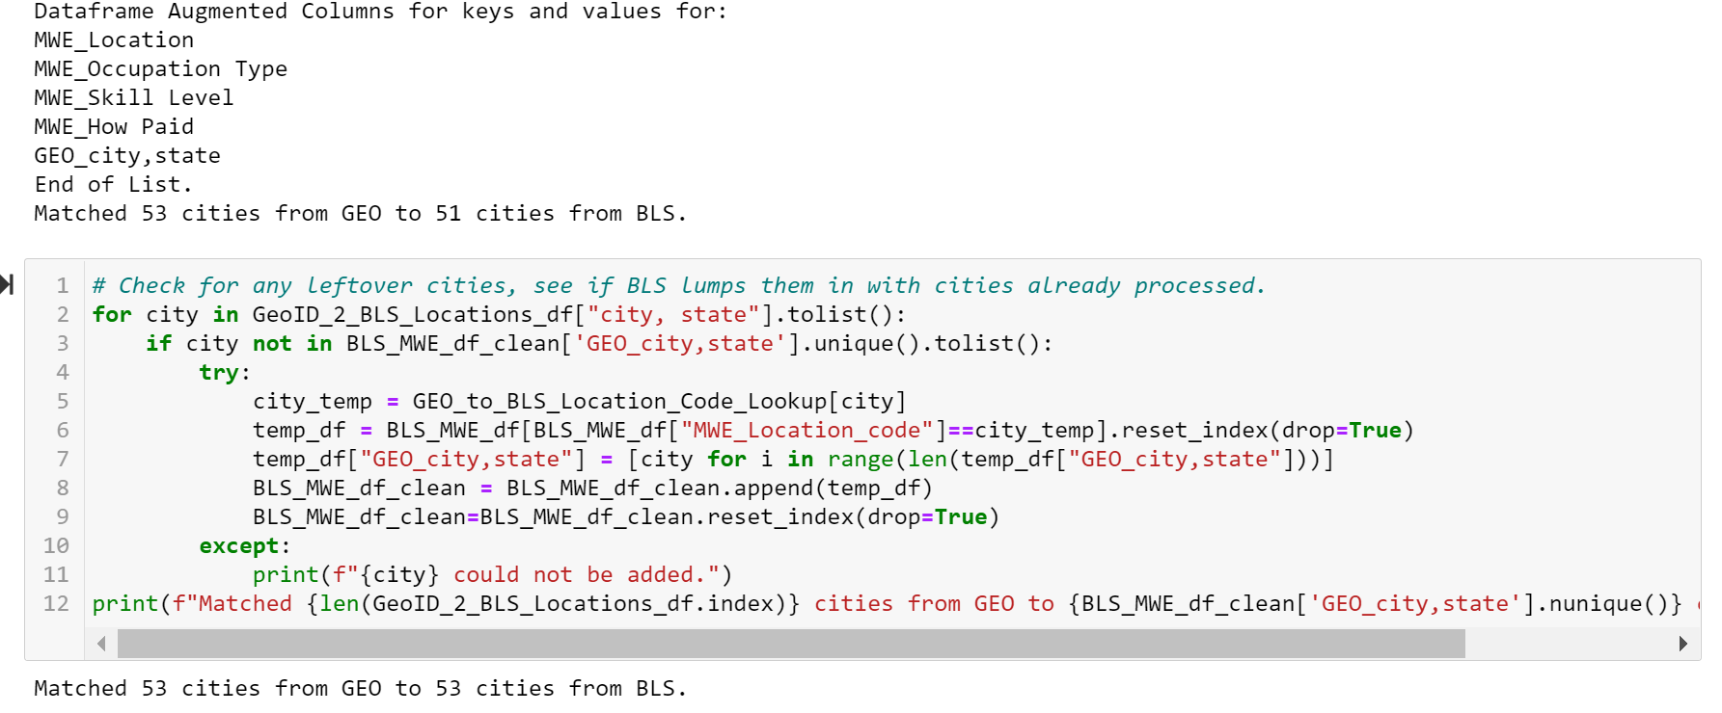
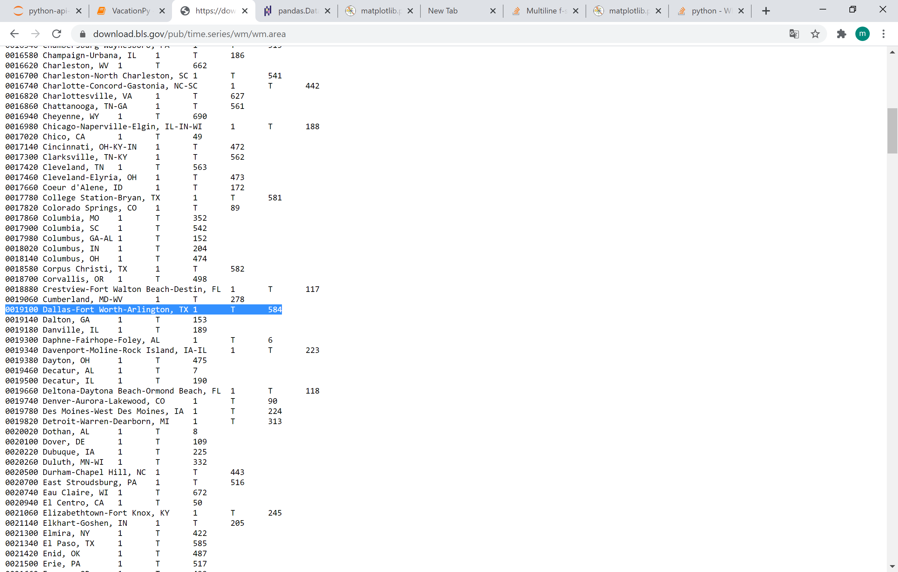
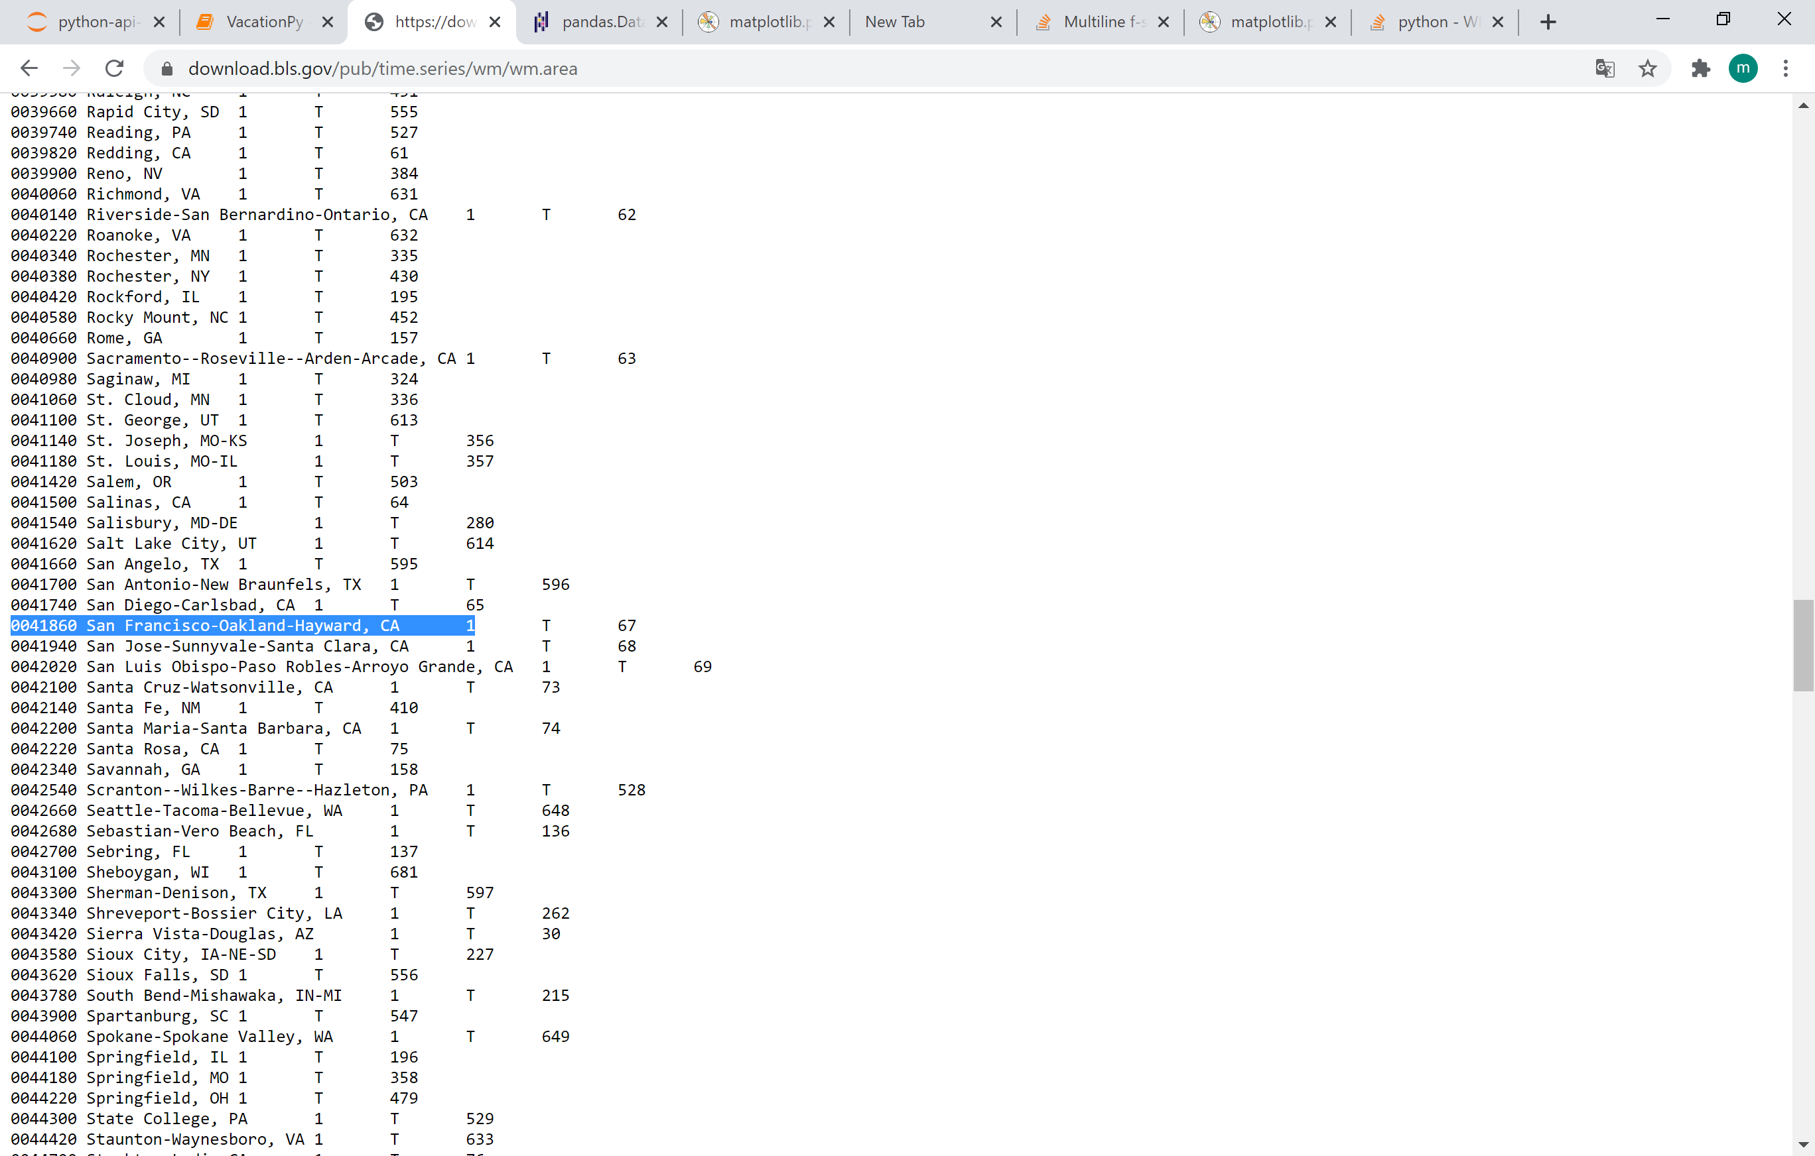
BLS MWE: Augmenting Results (City Matches)
BLS City Codes that Handle 2 Cities Each
Need to match regional dictionary values from the BLS to given cities in GEO.
A direct match means the city is listed as is, best match finds a BLS value that contains both city and state substrings. If those fail, the state was used (not actually invoked). If all else fails, city could not be added (not actually invoked).
Dallas, TX and Fort Worth, TX as well as San Francisco, CA and Oakland, CA were in single BLS group code. Since only one row was created for each pair, one city from each pair may be missing in the final merged dataframe.
The for-loop copies rows for paired city from the dataframe, modifies city name to the missing city in the copy, and then adds the rows back to the original dataframe so that the missing city is present with rows from the grouped code.

Slide 12
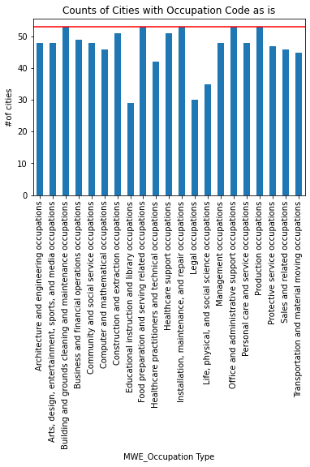
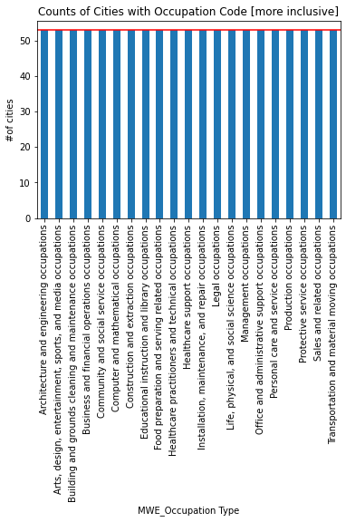
BLS MWE: Augmenting Results (Occupation)
Augmentation Process
With 53 cities from the GEO data, there should be 53 results from filtering the dataframe to a each of the 21 Occupation types.
However, some occupations have fewer results.
The occupations are given as industry (as shown) but also “how paid” set to full time and “level” set to all skill levels.
By loosening the how paid and skill level searches in a copy of the original data frame (city by city), taking the first row, and augmenting the original dataframe, the results are boosted to 53.
“how paid” and “skill level” are retained to ensure transparency of what was done.
Most results still in the desired format.

Slide 13
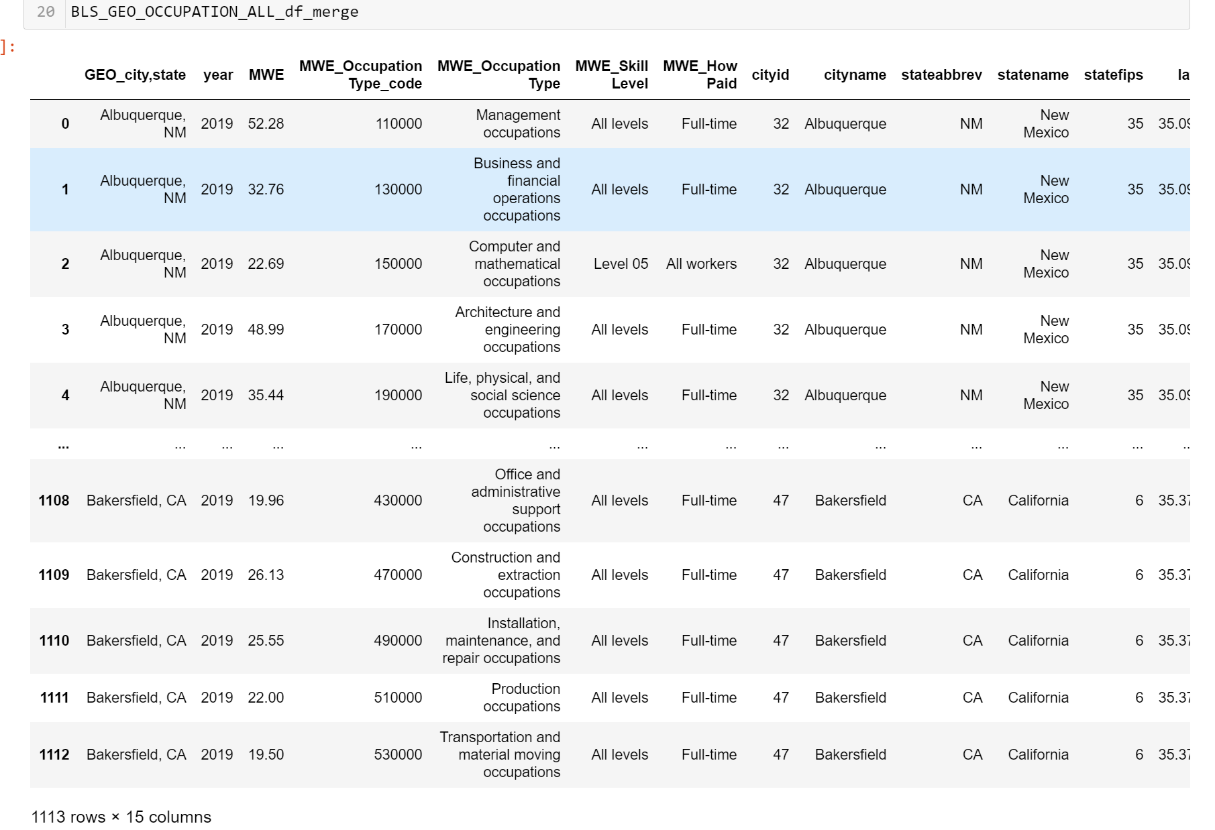
.csv Output
KEY TAKE AWAYS
Data is merged on GEO_city, state but is now able to be merged on cityid in future uses by importing the written .csv file.
One row exists for every chosen city/occupation combination.
Data displays loosened search parameters for occupation, where needed (how paid, skill level).
BLS MWE values in MWE column are provided for use or “Not Found” if data was unavailable.
Able to display expected $/hr from 2019 for any of 21 given occupations in any of 53 given cities, as defined by GEO. (GOAL!)
1,113 rows = 53 cities X 21 occupation types!

Slide 14
Data Analysis
Notes:
Good Morning, we are Greener

Slide 15
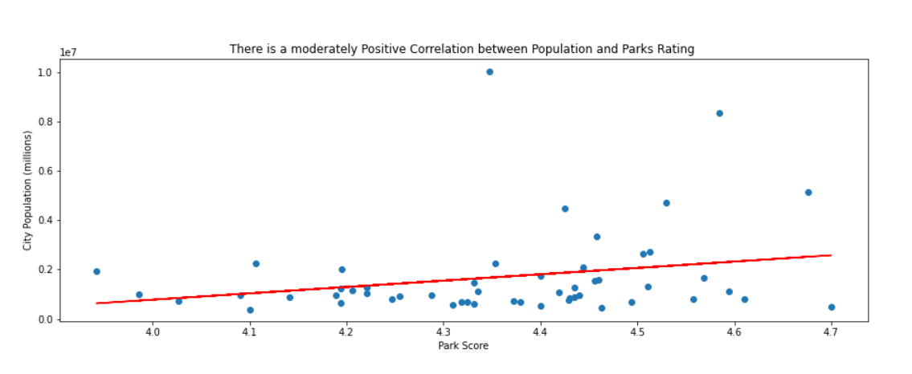
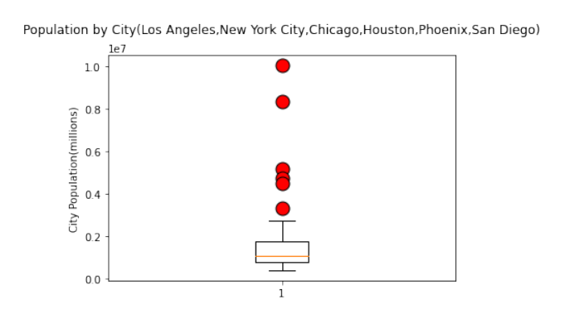
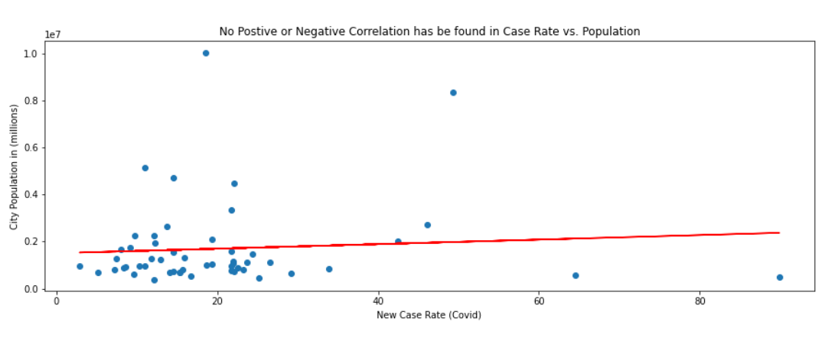
Data analysis
Moderate Positive Correlation
Out of 53, 6 cities were outliers due to the population size. The full data set was used.
No Correlation

Slide 16
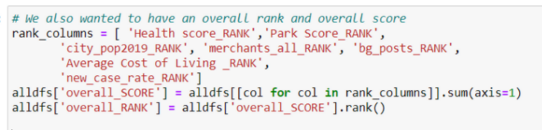
Ranking Process
In order to answer the question “Where should we go?”, a comprehensive raking process was used.
Am I looking for:
( )Better cost
( )Better Salaries
( )Better Parks
( )Better Health System
(X) ALL OF ABOVE

Slide 17
Discussion
Notes:
Good Morning, we are Greener

Slide 18
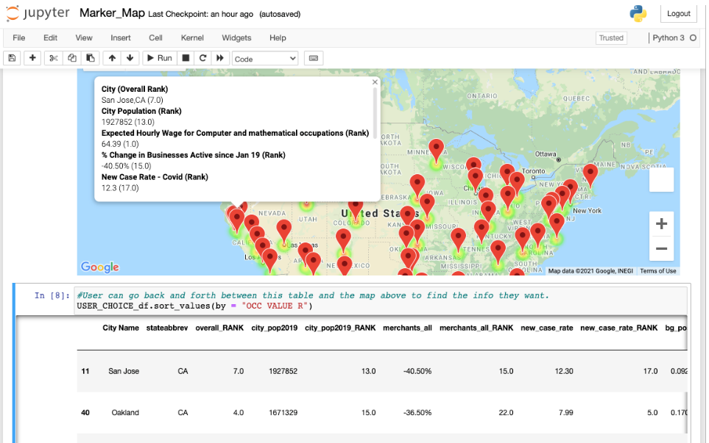
Greener Pasture Location
Example choice of: Computer and mathematical occupations
How Greener Pastures works:
User inputs occupation
A data frame is displayed listing the cities where the salary for that occupation is the highest
The map markers tooltips display the overall ranking for that city as well as the other needs and their individual ranks
The heatmap displays green where the overall rank is higher (1 is the highest)
*We can find your greener pasture on demand

Slide 19
Post Mortem
Notes:
Good Morning, we are Greener

Slide 20
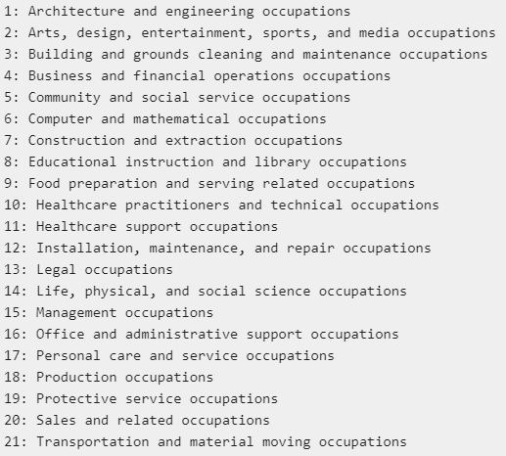
Difficulties & Future Improvements
Limitation on Occupation
Data, Time & Cost limitations/ improvements
BLS has more specific occupation listed, we limited because of time
Google API, limitation on radius size around the city's geo location due to data cost
Weighted ranking could be considered as future improvement
Determine which statistic most corelate with overall rank
More cities and more recent data would fuel this application

Slide 21
GeoIDs - City.csv from Economic Tracker used to determine list of 53 cities.
Input: BLS.gov
Input: NUMBEO.com (as csv)*
Input: Economic Tracker
(as csv)^
Input: Google Places API
Input: Economic Tracker
(as csv)^
Input: Economic Tracker
(as csv)^
Notebook: BLS_final
Outputs: BLS_GEO_OCCUPATION_ALL_df_merge.csv'
Output Location: /output_files
Notebook: Cost Of Living data Processing
Outputs: cost_of_living.csv
Output Location: /output_files
Notebook: jobOffers
Outputs: Job Postings.csv
Output Location: /output_files
Notebook: covid_data
Outputs: covidmerchant.csv
Output Location: /output_files
Notebook: heatmaps
Outputs: .png files (by month)
Output Location: /data/Heatmaps
Notebook: Health_Score
Outputs: HealthData.csv
Output Location: /output_files
Notebook: Park_Score
Outputs: parks_score.csv
Output Location: /output_files
Notebook: APPLICATION FINAL
Outputs: MegaDf.csv
Output Location: /output_files
Location: /data processing Py files
Notebook: Marker Map
Outputs: (Visual, in Notebook)
Output Location: N/A
Notebook: Heat Map display
Outputs: (Visual, in Notebook)
Output Location: N/A
Location: /final Presentation Files
Notebook: Plots
Outputs: .png files
Output Location: /Plots and Graphs

Slide 22





Questions
KYLE PAVELKA
kylepavelka1@gmail.com
RAVI PATEL
rp70960@gmail.com
MATT BROWN
matthewbrown84@gmail.com
MERI FRANCO
francomeriane@gmail.com
KEVIN SHEEKEY
ksheekey27@gmail.com
“Always dream and shoot higher than you know you can do. Don’t bother just to be better than your contemporaries or predecessors. Try to be better than yourself.” —William Faulkner

Slide 23
Retained Input Files Location: /data
^Economic Tracker
Burning Glass - City - Weekly.csv
COVID - City - Daily.csv
Employment Combined - City - Daily.csv
GeoIDs - City.csv
Job Postings.csv (from Burning Glass)
Womply - City - Daily.csv
*NUMBEO
Utilities.csv
Rent_1br.csv
Rent_3br.csv

